Slide 1
c/w Modern Virtue Ethicists 13/05/2020
Key Words
Virtue Ethics, Eudaimonia, V-Rules
Starter
Trolley Problem (2 min.) Answer the questions on the sheet.
Homework
Read and summarise the five virtue ethicists theories on p. 172-173.
Extension: List strengths and weaknesses for each virtue ethicist.
Notes:
For Kant, what makes an action right? (duty = rules)
For utilitarians what makes an action right? (consequence > maximise pleasure, minimise pain)
For virtue ethicists, what makes an action right? (if it would be done by the virtuous man, right action, in right circumstance, with right amount of feeling etc.)
What is a virtue?
How do we acquire virtues? (habituation)
What is meant by habituation?

Slide 2
Learning Objectives
By the end of the lesson
To describe some objections to Aristotle’s virtue ethics.
To explain how modern virtue ethicists have responded to those objections.
To evaluate modern virtue ethicists responses.

Slide 3
Key Words
Aretaic ethics
Another name for Virtue ethics, from the Greek word arete, which simply means any kind of excellence or virtue.
Eudaimonia
The final goal of all human activity - happiness, well-being, human flourishing.
Virtue
Habitually doing what is right - being good requires the practice of a certain kind of behaviour
Vice
The direct opposite of virtues - habitually wrong action.

Slide 4
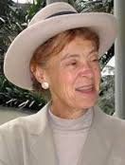
Hursthouse’s response
The Application Problem:
Virtue Ethics provides no guidance in moral dilemmas.
Rosalind Hursthouse responds to the application problem by showing how a virtuous person would think about a moral dilemma.
‘V-Rules’: from those virtues and vices we can derive rules e.g. courage = ‘be courageous!’
Some moral dilemmas impossible but that’s true of any ethical theory (deontological or teleological)
List 5 V-Rules derived from virtues, and 5 V-Rules derived from vices.

Slide 5
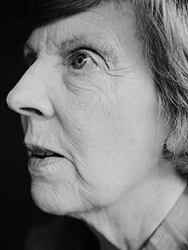
Foot’s response
Character Traits Problem:
Virtues can be put to a bad end e.g. a ‘courageous’ murderer
Philippa Foot responds the ‘character traits’ problem by claiming that a virtue does not operate as a virtue when turned to a bad end.
Cf. Aristotle “It is easy to get angry […] but to feel or act towards the right person to the right extent at the right time for the right reason in the right way – that is not easy, and it is not everyone that can do it.”
How would Foot respond to the ‘courageous murderer’?

Slide 6
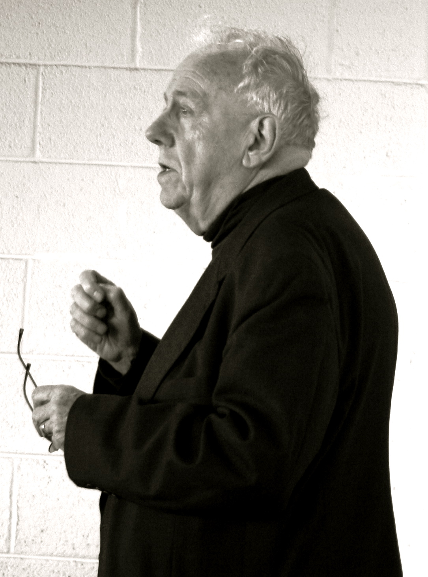
Macintyre’s response
Eudaimonia Problem:
The concept of eudaimonia (flourishing) depends on the fulfilment of a human telos (purpose) – but there may not be one!
Alasdair Macintyre concedes there may not be a human telos in the way that Aristotle thought.
However, we can still talk about how humans best flourish within a community.
Virtues are character traits that help the community to flourish e.g. courage = help protect community from enemies.
Evolutionary science supports idea humans are social animals and so reasonable to conceive ethics in terms of social communities.
What character traits would best serve our community today and how?

Slide 7
‘Virtue Ethics is of no use when dealing with practical ethics.’ Discuss.
This tells you the topic
What is meant by practical ethics?
e.g. medical, environmental, sexual, business ethics
Why would virtue ethics be of no use?
Agent-centered rather than act-centered
Leads to objections discussed today
It is not enough to simply list objections, to really answer the question you must evaluate the strength of the objections and reach a judgement on the original claim.
e.g. One reason why some argue virtue ethics is of no us is the application problem… However, this is a weak objection… Hursthouse clarifies how we may apply VE using V-Rules… Critics may argue this still doesn’t resolve moral dilemma. However, this is true of any ethical theory.

Slide 8
Exam Practice
A01: shows understanding; select and deploy relevant information, accurate use of technical terms.
A02: uses a range of evidence to sustain an argument, showing critical analysis of different viewpoints.
Virtue Ethics is of no use when dealing with practical ethics. Do you agree?
Introduction Aim: Context: establish what is meant by practical ethics and problems of agent-centered versus act-centered. Summary: argument to follow

Slide 9
Modern Virtue Ethicists
The Application Problem: VE provides no guidance in moral dilemmas. | Character Traits Problem: Virtues can be put to a bad end e.g. a ‘courageous’ murderer | Eudaimonia Problem: VE depends on a human telos - there may not be one.
Rosalind Hursthouse | Philippa Foot | Alasdair Macintyre
Her response: Shows how virtuous person would think about moral dilemma / V-Rules / Some moral dilemmas impossible but that’s okay. | Her response: A virtue does not operate as a virtue when turned to a bad end. | His response: Human flourishing depends on community / virtues evolve over time and serve community / evolutionary science supports idea humans social animals
Work: On Virtue Ethics | Work: Virtues and Vices | Work: After Virtue
To what extent do modern versions of Virtue Ethics address the weaknesses of Aristotle’s teaching on virtue? [35]

Slide 10
Review Questions
What is not happiness (eudaimonia) according to Aristotle?
What is happiness (eudaimonia) and how does it relate to function according to Aristotle? (use the analogy of the builder to explain)
What are virtues and how do they relate to vices? (Give 1 example, apply the Principle of the Golden Mean)
How do we acquire happiness? (h…)

Slide 11
Past Questions
June 2013
‘Businesses are completely incompatible with Virtue Ethics.’ Discuss.
January 2013
‘Following the example of virtuous people is the most useful aspect of Virtue Ethics.’ Discuss. [35]
January 2012
To what extent do modern versions of Virtue Ethics address the weaknesses of Aristotle’s teaching on virtue? [35]
June 2011
To what extent is Virtue Ethics helpful when making decisions about extramarital sex? [35]
June 2010
'The weaknesses of Virtue Ethics outweigh its strengths.' Discuss. [35]
June 2008
‘Virtue ethics is a good approach to the issues surrounding sex and relationships.’ Discuss. [45]

Slide 12
‘Virtue Ethics is of no use when dealing with practical ethics.’ Discuss.
A01: shows understanding; select and deploy relevant information, accurate use of technical terms.
A02: uses a range of evidence to sustain an argument, showing critical analysis of different viewpoints.
[Introduction; setting out problem of virtue ethics and applied ethics.]
There are various reasons why many scholars assert that Virtue Ethics has no relevance in practical moral decision making. The first of these criticisms lies in the nature of Virtue Ethics. Virtue Ethics is agent-orientated; it is about the virtuous nature of the individual. It is concerned with the moral outcome only insofar as those relates to the moral well-being of the moral agent. The agent-centered morality and lack of interest in the outcome of a moral decision is the primary reason why Virtue Ethics is of no use in practical ethics. Business ethics is concerned with maximisation of income, medical ethics with the outcome of an operation or treatment; and sexual ethics with the relationship between people. Virtue Ethics sees the outcome in terms of the moral agent’s excellence and not that of a company or hospital; therefore it is argued, it is of no use when dealing with practical decision-making and aims.

Slide 13
‘Virtue Ethics is of no use when dealing with practical ethics.’ Discuss.
A01: shows understanding; select and deploy relevant information, accurate use of technical terms.
A02: uses a range of evidence to sustain an argument, showing critical analysis of different viewpoints.
[Eudaimonia and telos]
Various criticisms can be made of Aristotle’s Virtue Ethics as an ethical approach. Firstly there is the imprecise nature of his idea of excellence, and whether it is relevant in practical ethics. For Aristotle, excellence was grounded on the eudaimonic quality of every organism. This can be applied to practical moral issues. Thus, a business can be seen to be an organism. According to Aristotle’s model, when each part of the organisation fulfils its function, purpose and end, then eudaimonia results. The employees are fulfilled, content and happy and so are the employer, shareholders and other stakeholders. When a business does not act as an interdependent organism then it suffers.
[Virtues and the Golden Mean]
Aristotle also asserts that the virtuous person lives according to the Golden Mean. For example, an international banker or an officer in the army must be careful not to be reckless when dealing with customers or the lives of their troops. Yet, neither can they afford to be cowardly when making risky decisions. The Golden Mean, it is argued, sets the moral position that is required to all who are engaged in practical ethics.

Slide 14
‘Virtue Ethics is of no use when dealing with practical ethics.’ Discuss.
A01: shows understanding; select and deploy relevant information, accurate use of technical terms.
A02: uses a range of evidence to sustain an argument, showing critical analysis of different viewpoints.
[The problem of conflict]
Is this view of how individuals should function in society of use when applied to practical ethics today? Aristotle gives a perfect model for how businesses should function but it can be questioned whether employees see their role in life in terms of maximising wealth of the company. There may also be conflicting means. A worker’s means is to work hard. But is it virtuous to work hard when your wife is dying in hospital? The person’s mean as a husband will differ from their mean as an employee. Aristotle’s Virtue Ethics, it is argued, has no solution to this problem of conflict.
[The problem of phronesis]
Aristotle saw this conflict as being resolved through phronesis, the practical and rational thinking through of a problem. However, this can also be seen as a weakness because practical ethics sometimes requires quick decision-making.

Slide 15
‘Virtue Ethics is of no use when dealing with practical ethics.’ Discuss.
A01: shows understanding; select and deploy relevant information, accurate use of technical terms.
A02: uses a range of evidence to sustain an argument, showing critical analysis of different viewpoints.
[The problem of character traits]
Many modern Virtue Ethicisits have turned away from the principle of the Golden Mean and the organic nature of moral excellence and virtue. Instead they rely on character traits. They argue that developing character traits will lead to a moral society, company, hospital etc. Writers such as Philippa Foot regard the development of character traits such as fairness, justice and courage as being vital practical ethics. However, critics of the approach question this position. What makes one human characteristic more virtuous than another? Is courage a good trait to have when deciding whether or not to use a condom for example. Courage implies risk, so in this case cowardice would be the best moral position. Critics also do not see how such character traits can be applied to practical issues. They are essentially self-centered, and here critics return to the problem with the agent-centered nature of Virtue Ethics

Slide 16
‘Virtue Ethics is of no use when dealing with practical ethics.’ Discuss.
A01: shows understanding; select and deploy relevant information, accurate use of technical terms.
A02: uses a range of evidence to sustain an argument, showing critical analysis of different viewpoints.
[Conclusion]
In support of Virtue Ethics as a useful theory for approaching practical ethics, it can be argued that its stress on the individual’s moral nature, on the virtues and on human emotions can be useful when applied to, for example, issues of sexual morality. Its rejection of simple rules, such as the greatest good for the greatest number, can be seen as a positive aspect that fits well with a modern understanding of the world. Virtue Ethics recognises that many practical moral issues cannot be solved. What it attempts to do is to equip the moral agent with the ethical tools they need to problem solve. Thus, Virtue Ethics can be seen to be useful to practical morality, despite its limiations.

